Slide 1
Grails Controllers
Sachin Verma

Slide 2
Agenda
What’s MVC?
Controller - Definition and Usage
Role played by controller in MVC
Action
Scaffolding - Static and Dynamic
Rendering Views And Models - Basic
Redirecting And Forwards
Controller Scopes – Params ,session, flash scope
Interceptor

Slide 3
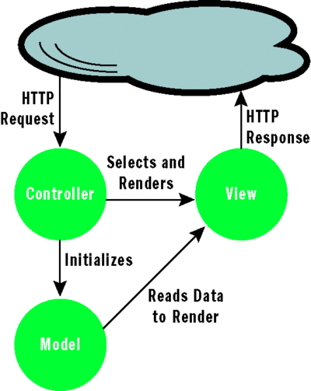
MVC Architecture

Slide 4
Defining a Controller
A class defined under grails-app/controllers directory
Name ends with Controller as a convention; appended to end of controller name by default
grails create-controller sample
Are request-scoped, i.e. a new instance is created for every request

Slide 5
Actions
Actions are groovy closures, each of these actions maps to a URI
def myFirstAction() {
render “Sample controller Accessed”
}
Every controller has a number of actions; the above example maps to <....>/sample/myFirstAction
(SampleController is the name of the controller)
Actions name starting with “get***” should be avoided.

Slide 6
Scaffolding
Grails allows you to use dynamically generated code to get you started
Set the property 'scaffold' of a controller to true to generate code on the fly
def scaffold = true
def scaffold = Author // Author is a domain class
Views generated are HTML5 compliant since Grails 2.0.0

Slide 7
Scaffolding by types
Dynamic Scaffolding
def scaffold=Author
It will provide all the artifacts only on run time i.e while application is up. One can't modify the views/gsps, so one has to use only default views.
Static Scaffolding
grails generate-all Author
grails generate-all "*" //For generating for all domain classes
It will generate all the artifacts like AuthorController, show.gsp,edit.gsp.. etc
Here one can modify views/gsps as the all things of code are made static.

Slide 8
Demo

Slide 9
Actions : Setting Default
There are 3 ways to define the default action of a controller
Create an action named index
def index () {
render “The action is right here – at index”
}
Define a property named defaultAction
static defaultAction = “myFirstAction”
def myFirstAction() {
render ”WooHoo!!”
}

Slide 10
Restricting access to controller
By default all controller actions are accessible using any HTTP request method (GET, PUT, POST, etc...).
request.getMethod()
To restrict this, define a map by the name of allowedMethods
Every key of this map specifies the action name and the value of a key specifies the request method that the action should be allowed
static allowedMethods = [action1: 'POST',
action2: ['POST', 'GET', 'DELETE']]
Notes:
If a domain class has a method called getName() and a method called setName(), then that domain class has a persistent property called name. It doesn’t matter that the class doesn’t have a field called “name.”

Slide 11
Rending the view
Based on convention, a gsp by the same name as the action is searched for, if no view is specified explicitly
def myFirstAction = {}
When trying to access this action, a view with the name of myFirstAction.gsp will be searched. If not found, it will give a 404 error
To render a custom view, use the render method. render(view:"display")

Slide 12
Creating a model
A key duty of the controller is gathering data that will be rendered in the view
The collected data is put in a map called model
class SampleController {
def show = {
render(view: 'show', model: [song: Song.get(1) ]
}
}

Slide 13
Demo

Slide 14
Redirecting a request
Passing control to another action within or outside the same controller
Redirect method accepts a map as an argument
redirect(controller: 'sample', action: 'first')
Arguments : action, controller, id, params, uri, url

Slide 15
Redirect and Forward
Forward:
Is performed internally by the servlet
Original URL stays intact
Redirect
Two step process - web application instructs the browser to fetch a second URL, which differs from the original
Slower than a forward, since it requires a
second browser request

Slide 16
Some Examples
forward action: "show", id: 4, params: [author: "Stephen King"]
forward (controller: "book", action: "show")
redirect(action:login)
redirect(controller:'home',action:'index')
redirect(uri:"/login.html")
redirect(url:"http://grails.org")
redirect(action:myaction,params:["myparam":"myvalue"])

Slide 17
Controller Scopes
servletContext : allows us to share state across the entire web application.
session : allows associating state with a given user.
request : allows the storage of objects for the current request only.
params - map of incoming request parameters
flash : Objects placed in this scope are kept for the duration on the current request and the next request
Notes:
The value of the belongsTo property in the Engine class is a Map.

Slide 18
Params and session
“params” is a map consisting of incoming request parameters for the controller action
def paramsUsage = {
render “I got the following name: ” + params.name
}
“session” is a map that can be used to store data pertaining to a user; uses cookies to associate a particular state with a user.
def sessionsUsage = {
render “I got the following name: ” + session.name
}

Slide 19
Request Attributes
The following properties are directly accessible in a controller
actionName : Currently Executing Action
actionUri : Relative URI of the action
controllerName : Currently executing controller
controllerUri : Relative URI of the action
response : An HttpServletResponse object

Slide 20
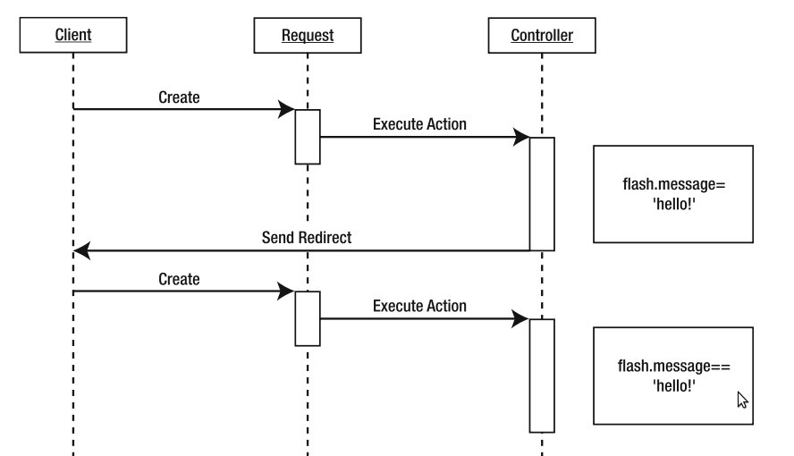
Flash scope
A special scope which is available for two requests
Useful in the case of a redirect

Slide 21
Demo

Slide 22
Scoped Controllers
By default, a new controller instance is created for each request
You can change this behaviour by placing a controller in a particular scope.
static scope = "singleton"
Prototype
Session
Singleton
You can define the default strategy under in Config.groovy
grails.controllers.defaultScope = "singleton"

Slide 23
Before Interceptor
The 'before' interceptor intercepts processing before the action is executed.
If it returns 'false' then the following action will not be executed.
def beforeInterceptor = {
println "Tracing action ${actionUri}"
}

Slide 24
Before Interceptor
An action can also be specified to be executed as a before interceptor
def beforeInterceptor = [action: this.&myAction]
def myAction() { println “Hello World!!” }
Also specify that before interceptor be not applied to certain action using the 'except' parameter
Or specify interceptor to be executed for only one action using the 'only' parameter

Slide 25
After Interceptor
“afterInterceptor” is executed after an action
The after interceptor takes the resulting model as an argument and can hence perform post manipulation of the model or response.
def afterInterceptor = { model ->
println "Tracing action ${actionUri}"
}
def afterInterceptor = { model, modelAndView ->
println "Current view is ${modelAndView.viewName}"
if(model.someVar) modelAndView.viewName = "/mycontroller/someotherview"
println "View is now ${modelAndView.viewName}"
}

Slide 26
After Interceptor
Similar to a before interceptor, an action can also be specified to be executed as an after interceptor
def afterInterceptor = [action: this.&myAction]
private myAction(model) { println “Ghost!!” }
The parameters 'except' and 'only' can also be used in after interceptor

Slide 27
Demo

Slide 28
Data Binding: Implicit Constructor
Album album = new Album(params)
By passing the params object to the domain class constructor Grails automatically recognizes that you are trying to bind from request parameters. When incoming request is like :
/book/save?title=grails
Then the title request parameters would automatically get set on the domain class properties with similar name.
Notes:
A set of services, APIs and protocols. Multi Tiered web applications.
A Standardized way of doing things. Decreases the need for programming a lot of features which are already available as re-usable components.

Slide 29
Data Binding: Using “properties”
If you need to perform data binding onto an existing instance then you can use the “properties” property :
def album = Book.get(params.id)
Book.properties = params //Update Existing Record
Note : This has exactly the same effect as using the implicit constructor (Just can used for existing record updation).
Notes:
A set of services, APIs and protocols. Multi Tiered web applications.
A Standardized way of doing things. Decreases the need for programming a lot of features which are already available as re-usable components.

Slide 30
Data Binding: bindData method
Enables inclusion/exclusion of properties to be included while binding the data
bindData(album, params, [ include : [ 'title' , 'type' ] ])
Include : Specify only 'title' and 'type' property bind to album.
bindData(album, params, [ exclude : "title" ])
Exclude : Specify bind all the property excluding 'title'.
Notes:
A set of services, APIs and protocols. Multi Tiered web applications.
A Standardized way of doing things. Decreases the need for programming a lot of features which are already available as re-usable components.

Slide 31
Demo

Slide 32
References
http://samet.kilictas.com/what-is-mvc-architecture-model-view-controller/
http://grails.org/doc/latest/guide/theWebLayer.html#controllers

Slide 33
Questions ?

Slide 34
Thank You

